Slide 1

Dial in (Main): (415) 655-0052
Dial in (Alt): (951) 266-6125
Attendee Access Code: 916-821-035
Slides in “Handout” Tab
ORD Research Updates:
COVID-19 & Mental Health
September 10, 2020

Slide 2
Webinar Goals & Agenda
Goals
Bring together researchers working to understand and address the impacts of COVID-19 on mental health
Identify areas of potential synergy
Foster communication & collaboration
Agenda
Overview of ORD efforts
Research Highlights
  Jennifer Loftis, PhD (CSRD)
  Alan Teo, MD, MS (HSRD)
  Bryan DeBeer, PhD (HSRD)
  Michael Green, PhD (RRD)
Discussion/Q&A

Slide 3
ORD Updates: COVID & Mental Health
COVID-19 Pandemic
Mental health (MH) impacts of COVID are substantial
ORD Response
Clinical Services Research & Development (CSRD) | Terri Gleason, PhD – Director
  Study the physiological effects of COVID-19, examine diagnostic and other testing procedures, and evaluate clinical interventions to improve patient outcomes
    1 pilot study funded from 3 rounds of rapid response solicitation
Health Services Research & Development (HSRD) | David Atkins, MD, MPH - Director
  Investigate and address impacts of COVID-19 pandemic and response on clinical care and delivery, patient and provider outcomes, and the VA healthcare system
    9 studies (9-month duration) funded from 2 rounds of rapid response solicitation
Rehabilitation Research & Development (RR&D) | Karen Lohmann Siegel, PT, MA - Deputy Director
  Develop and evaluate interventions which will enable Veterans with physical or psychological disabling conditions to function more fully in society (and mitigate the impacts of COVID-19)
    9 studies with project modifications to collect additional information related to COVID-19

Slide 4
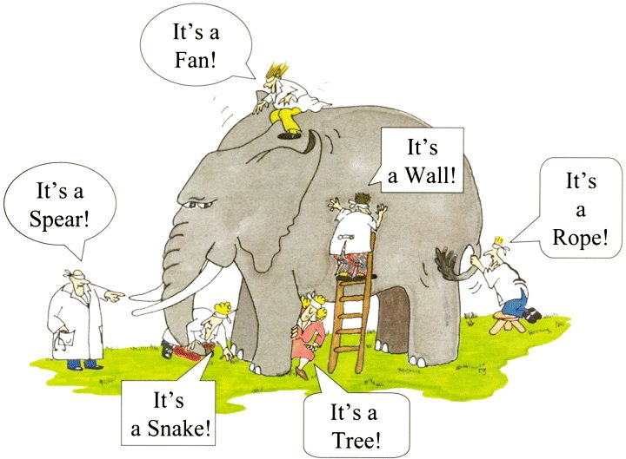
Building A More Complete Picture of COVID and Mental Health

Slide 5
Causal Framework for COVID Impacts on Mental Health
COVID-related anxiety
Clinical & Behavioral Outcomes*
Activities
Functioning
Family relationships
Mental Health Symptoms
Physical Health
Substance Use
*Potential relationships (and effects) among variables within this set.
Populations at Risk
General Veteran Population
Veterans with MH Conditions (MDD, PTSD, Substance Use)
Other Vulnerable Populations (Aging, Homeless, Residential, Rural)
C
COVID Infection
Local COVID severity
Public Health Response
Restrictions (schools and daycares, residential living facilities, business, travel)
Shelter in Place Measures
Social Distancing Measures
Intermediate Outcomes*
Basic Needs (e.g., food, housing, income)
Medical Care (access, utilization, adherence)
Social Support (access to social services, community support & integration, social connectedness)
*Potential mediators or moderators of clinical/behavioral outcomes
Interventions to Address Mental Health
Both COVID and non-COVID specific
Interventions to Address Medical, Social, and Economic Resource Needs

Slide 6
Summary of Studies Funded (1/2)
Populations Studied
  Veterans (general population)
  Veterans with Mental and/or Behavioral Health Conditions (MDD, PTSD, substance use)
  Other Vulnerable Populations (aging, homeless, residential rehab, rural)
Interventions
  Outreach (suicide prevention)
  Peer support
  Psychotherapy (supplement to RRD studies) – Adaptive Disclosure, Cognitive Behavioral Conjoint Therapy, Compassion Meditation, Present-Centered Therapy, Prolonged Exposure Therapy
  Policy responses in Residential rehabilitation & treatment
  Self-help interventions
  Telehealth delivery of mental health services
  TMS (supplement to RRD studies)
  Topiramate (supplement to RRD study)

Slide 7
Summary of Studies Funded (2/2)
Mediators (Intermediate Outcomes) Examined
  Reduced basic resources (food security, housing stability, income)
  Reduced medical care (access & utilization)
  Reduced social connectedness
Clinical & Behavioral Outcomes Measured
  Anxiety
  Cognition
  Depression
  Functioning
  Loneliness
  Mood
  PTSD
  Suicidal Ideation
  Physical health
  Substance use
  Well-being

Slide 8
Next Steps
MH Workgroup
  Voluntary convening of ORD-funded researchers (~20)
  Sharing information on common measures
  Improving our understanding of isolation as a mediator of adverse effects
  Learning across studies from early results
Preparing for Future Lockdowns or Disasters
  Who is at highest risk of doing poorly?
  What targeted interventions can prevent worsening of mental health symptoms?

Slide 9

INFLAMMATORY AND MENTAL HEALTH SEQUELAE OF COVID-19 IN VETERANS
Principal Investigator: Jennifer Loftis, Ph.D.
Co-Investigator: Alan Teo, M.D.
ORD Research Updates: COVID-19 and Mental Health September 10, 2020

Slide 10
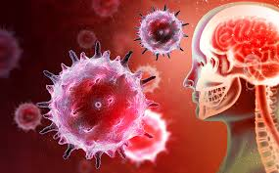
Background and rationale
Coronavirus is associated with a history of mood disorders (Okusaga et al., 2011).
Inflammatory factors play a significant role in virus-induced depressive symptoms, anxiety, and cognitive impairments (Huckans et al., 2014).
When COVID-19 infects the respiratory tract it can cause mild or severe disease, with release of pro-inflammatory cytokines, IL-1β and IL-6 (Wang et al., 2020)—inflammatory factors implicated in depression and other neuropsychiatric symptoms (Loftis et al., 2008; Valkanova et al., 2013).
Okusaga et al., J Affect Disord, 2011; Huckans et al., Brain Behav, 2014; Wang et al., Clin Infect Dis, 2020; Loftis et al., Neurosci Lett, 2008; Valkanova et al., J Affect Disord, 2013

Slide 11
Steardo et al., Psychiatric face of COVID-19. Transl Psychiatry, 2020

Slide 12
The objective of this project is to conduct a prospective pilot study that will allow us to begin to determine the inflammatory and mental health sequelae of COVID-19 in Veterans.
It is hypothesized that Veterans positive for SARS-CoV-2 with COVID-19 disease symptoms will have:
higher levels of pro-inflammatory cytokines and
report a greater severity of mental health symptoms, as compared to Veterans who do not test positive for SARS-CoV-2 and to those who test positive but do not experience symptoms.

Slide 13
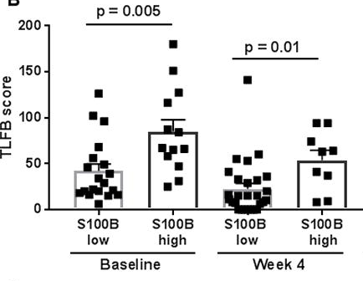
Aim 1: Baseline biomarker and mental health assessment
At the time of COVID-19 testing we will determine baseline symptoms of depression, anxiety, fatigue, and cognitive complaints using self-administered rating scales.
Electronic medical records will be used to obtain relevant demographic and medical data, including suicide risk.
Levels of peripheral inflammation will be evaluated in plasma by immunoassays.
Blood brain barrier (BBB) integrity will be measured by plasma S100B concentration.
Loftis et al., S100B and Inflammatory Cytokine Levels in Blood as Potential Markers of Blood-Brain Barrier Damage and Psychiatric Impairment in Comorbid Hepatitis C Viral Infection and Alcohol Use Disorder. Alcohol Clin Exp Res, 2018

Slide 14
Procedure | Description
Brief Questionnaire Battery | Self-administered rating scales to screen for mood disorders, somatic symptoms, and cognitive problems
Patient Health Questionnaire-9 (PHQ-9) | 9-item measure of depression severity
Generalized Anxiety Disorder-7 Scale (GAD-7) | 7-item measure of anxiety severity
Fatigue Severity Scale (FSS) | 9-item measure of fatigue
Prospective Retrospective Memory Questionnaire (PRMQ) | 16-item measure asking participants to rate the frequency with which they are having problems with aspects of everyday memory functioning
Blood Sample Collection | To obtain plasma for determination of immune factor and S100B levels

Slide 15
Immune factor (abbreviation)
C-reactive protein (CRP)
Interferon (IFN) -γ
IFN-γ-inducible protein 10 (IP10; CXCL10)
Interleukin (IL) -1β
IL-2
IL-2 receptor (IL-2R)
IL-4
IL-6
IL-8/chemokine (C-X-C motif) ligand 8 (CXCL8)
IL-10/human cytokine synthesis inhibitory factor (CSIF)
Monocyte chemoattractant protein 1 (MCP-1)/chemokine (C-C motif) ligand 2 (CCL2)
Monokine induced by IFN-γ (MIG; CXCL9)
Regulated on activation, normal T cell expressed and secreted (RANTES)/CCL5
Tumor necrosis factor (TNF) -α

Slide 16
Aim 2: Post COVID-19 biomarker and mental health assessment
Veterans tested for COVID-19 (from Aim 1) will be asked to provide a second blood sample and to complete the same self-report measures of depression, anxiety, fatigue, and cognitive complaints as done at baseline.
We will collect data from Veterans who do and do not test positive for COVID-19; for participants who do not test positive or develop disease symptoms, we will collect follow-up data at comparable time points.
Inflammatory factors and S100B will be measured.
Identifying the mental health sequelae of COVID-19 can lead to better understanding of how to target prevention, evaluation, and treatment of neuropsychiatric symptoms among Veterans with future viral infections.

Slide 17


ACKNOWLEDGEMENTS
Alan Teo, M.D.
Holly Villamagna, M.D.
Christopher Pfeiffer, M.D.
Annette Lopez, M.D.
Research personnel
Evan Firsick, B.S.
Kate Shirley, M.A.
Rebekah Hudson, B.S.
Bethany Winters, M.A.
Aaron Call, Ed.M.
VA Portland Health Care System, Portland, OR
Veterans and those participating in our research
Clinical Science Research & Development Service (COVID19-8900-14); Biomedical Laboratory Research & Development Merit Review Award (1I01BX002061)

Slide 18

Contact Information
Jennifer Loftis, Ph.D.
Email: Jennifer.loftis2@va.gov; loftisj@ohsu.edu
Psychoneuroimmunology Research Team http://www.ohsu.edu/pniresearch
Methamphetamine Research Center
https://www.ohsu.edu/methamphetamine-research-center

Slide 19


Adapting Caring Contacts to Counteract Adverse Effects of Social Distancing During COVID-19 (HSR&D grant C19 20-216)
Alan R. Teo, M.D., M.S.
VA Portland Health Care System
Oregon Health & Science University
Email: teoa@ohsu.edu
Twitter: @psychteo
Website: DrAlanTeo.com
September 10, 2020

Slide 20
Research Team
Co-Investigators
  Jennifer Barton, MD, MCR
  Kathleen Carlson, PhD
  Lauren Denneson, PhD, MS
  Sara Landes, PhD
Expert Panel
  Liz Karras-Pilato, PhD
  Tiffany Knight (Veteran)
  Linda Langford, ScD
  Monireh Moghadam, LCSW
  Mark Reger, PhD
  Gary Roberts (Veteran)
  Jack Woods, LCSW (Veteran)

Slide 21
What are Caring Contacts?
Concept: Brief, caring, and non-demanding messages
Target population: Patients at elevated risk of suicide with recent contact with the healthcare system
Theory: Reduce suicide risk by enhancing feelings of social connectedness

Slide 22


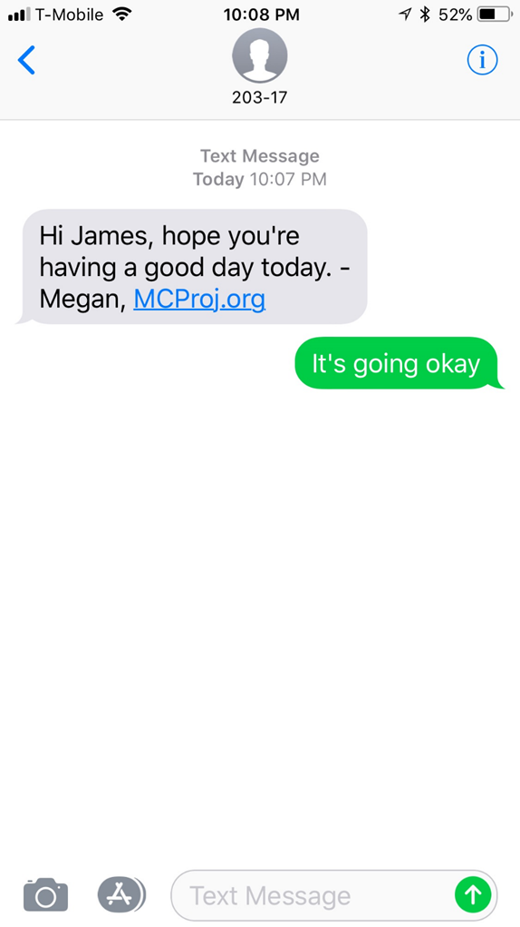
Carter et al., 2005
Comtois et al., 2019

Slide 23
What’s the evidence for Caring Contacts?
Number of Studies: 10 studies across 5 countries.
Modalities: Letter, Letter + Phone, Postcard, Text Message, or Email.
Effectiveness: 5 studies found reductions in suicide deaths, suicide attempts, and/or suicide ideation at one and two-year follow-up. 2 showed no significant effects. 1 showed an increase of self-harm. 1 showed cost-effectiveness.
Military/Veteran Population: Studies on both active duty service members and veterans have shown feasibility, acceptability, and reduction in suicidal ideation and suicide attempts.

Slide 24
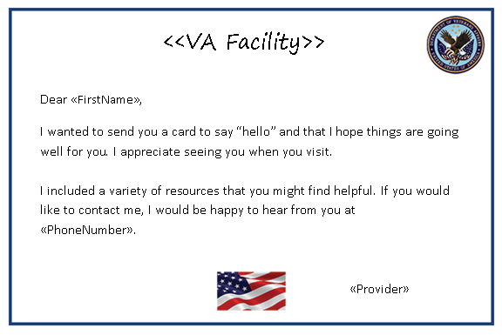
Caring Contacts is undergoing some implementation

Slide 25
COVID-19 and other disasters
Concern for the accumulation of negative psychosocial consequences from COVID-19 over time, and some early evidence of rising mental health distress and loneliness amidst COVID-19.
Rates of depression, anxiety, and perhaps suicide rise after disasters.
Extensive research demonstrating the importance of social connections to physical and mental health.
Source: https://www.healthaffairs.org/do/10.1377/hblog20200609.53823

Slide 26
Key Premises of the Current Project:
1. Caring Contacts can be adapted and tailored to the context of the COVID-19 pandemic.
2. Receipt of “Crisis Caring Contacts” will increase sense of social connection among Veterans at risk for negative mental health consequences from COVID-19.

Slide 27
Specific Aims
Aim 1: Convene a panel of subject matter experts and Veterans who will develop an adapted intervention (“Crisis Caring Contacts”).
Aim 2: Identify a cohort of high-risk Veterans from which to recruit participants for an RCT of Crisis Caring Contacts.
Aim 3: Create data collection instruments, human subjects and safety protocols, and all other procedures and documents required for conduct of a pragmatic RCT of Crisis Caring Contacts.

Slide 28
Convene Expert Panel
Use planning guide to adapt Caring Contacts
Construct cohort of high-risk Veterans
Develop data collection instrument and outcome measures
Create procedure for administrative data linkage
Prepare IRB protocol and grant application for future RCT

Slide 29
Convene Expert Panel
Use planning guide to adapt Caring Contacts
Construct cohort of high-risk Veterans
Develop data collection instrument and outcome measures
Create procedure for administrative data linkage
Prepare IRB protocol and grant application for future RCT

Slide 30
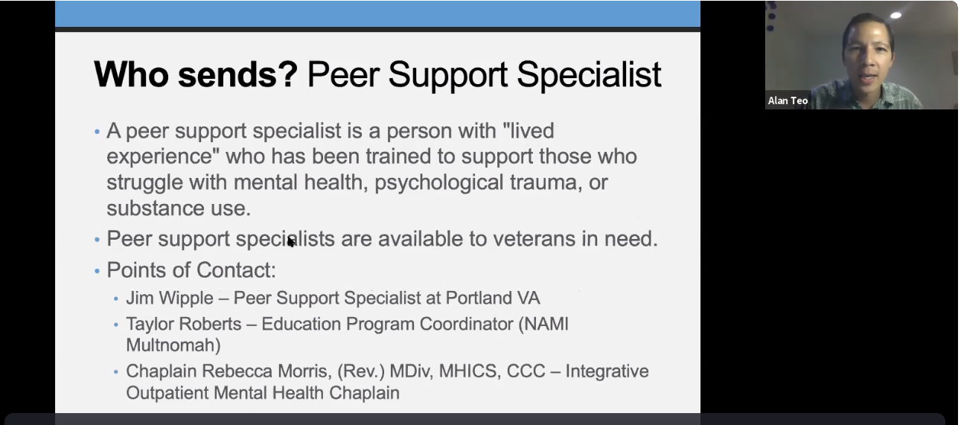

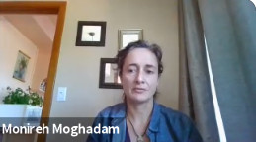
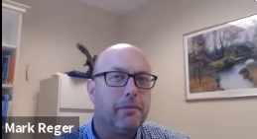

Slide 31
Convene Expert Panel
Use planning guide to adapt Caring Contacts
Construct cohort of high-risk Veterans
Develop data collection instrument and outcome measures
Create procedure for administrative data linkage
Prepare IRB protocol and grant application for future RCT

Slide 32
Implementation Planning Guide
Roles/Tasks | Actionable Items/Examples* | Current Status/Potential Barriers/Notes
E. Determine Who Administers Crisis Caring Contacts | Possible senders: Social Worker Peer Support Specialist Combination Protocol for managing replies received | Social work Services: Many veterans first POC Many veterans regard as person who is caring and looking out for my health Letter wouldn’t come as a surprise from social work services Peer Support Specialist: Does not know veteran personally Could we send cards from a team of people? This might seem more natural than a specific person
Adapted from: Landes et al. Pilot and Feasibility Studies, (2019) 5:115

Slide 33
Convene Expert Panel
Use planning guide to adapt Caring Contacts
Construct cohort of high-risk Veterans
Develop data collection instrument and outcome measures
Create procedure for administrative data linkage
Prepare IRB protocol and grant application for future RCT

Slide 34




Crisis Caring Contacts Draft Message
Dear <First Name> <Last Name>, I am a Peer Support Specialist contacting other Veterans on behalf of the VA. We are reaching out to people we haven’t seen recently to wish them well during these times. The COVID-19 pandemic has been hard on many of us. If you’d like to connect, please feel free to contact me. JW and your Peer Support Specialist team 503-123-4567

Slide 35
Challenges and key questions
Identifying indicators of social isolation using administrative data (CDW)?
Operational partner?
Funding source?
Potential VA sites for an RCT of Crisis Caring Contacts?

Slide 36
The Impact of COVID-19 and Social Distancing on Mental Health and Suicide Risk in Veterans
Bryann B. DeBeer, Ph.D.
Director, VA Patient Safety Center of Inquiry – Suicide Prevention Collaborative
Clinical Research Psychologist, Rocky Mountain MIRECC for Suicide Prevention
Visiting Associate Professor, University of Colorado, Anschutz Medical Campus

Slide 37
Disclaimer and Acknowledgements
The views expressed are my own and do not reflect the official position of the VA, University of Colorado, or other affiliates.
This work is supported through a COVID Rapid Response Award from Health Sciences Research and Development at the Department of Veterans Affairs awarded to Dr. Bryann DeBeer.

Slide 38
Background
Approximately 17 Veterans die by suicide each day (VA, 2019)
Many Veterans experience mental health disorders (Seal et al., 2007)
Social support impacts mental health and suicide risk (DeBeer et al., 2014)

Slide 39
Background
COVID-19 mandatory quarantines and social distancing practices
  Effects of social isolation and pandemic stressors are unknown
    Veteran mental health and well-being
    Decreased sense of belonging, loneliness, low social support
    Factors that are connected to suicide risk (DeBeer et al., 2014; Joiner et al., 2005)

Slide 40
Study Aims
Investigate the impact of changes to one’s social support system, due to social distancing, on mental health and suicide risk, as well as moderators of this association
  Hypotheses: Decreases in the connectedness of the social support system due to social distancing, assessed via retrospective social network analysis, will be associated with:
    Greater severity of mental health symptoms and moderated by modifiable factors
    Greater suicide risk and moderated by modifiable factors

Slide 41
Methods
Cross sectional survey study
Recruiting 200 Veterans enrolled in the national VHA system via mailed letters
Oversampling
  Mental health diagnoses
  Positive COVID diagnosis
One-time, 90-minute online survey

Slide 42
Variables and Measures
Social Factors
  Social Network Analysis
    Identify personal support networks
    Type, trust, dependency, support, importance, and networking
    Changes in network that have occurred during the pandemic

Slide 43
Variables and Measures
Social Factors
  Social Support
    Interpersonal Support Evaluation List
  Belongingness
    Interpersonal Needs Questionnaire
  Loneliness
    UCLA Loneliness Scale
  Expressed emotion
    Perceived Criticism Scale

Slide 44
Variables and Measures
Mental Health
  Mental health symptoms
    Depression - Patient Health Questionnaire – 9
    PTSD - PTSD Checklist – 5
  Suicidal thoughts
    Beck Scale for Suicidal Ideation
Alcohol Use
  CAGE Substance Abuse Tool

Slide 45
Variables and Measures
COVID-19
  COVID-19 Questionnaire
  Coronavirus Impact Scale
  Epidemic-Pandemic Impact Inventory
  COVID-19 Family Stress Screener

Slide 46
Variables and Measures
Modifiable Treatment Factors
  Social cognition
    Ambiguous Intentions Hostility Questionnaire
  Psychological inflexibility
    Acceptance and Action Questionnaire – II
  Expressed emotion
    Perceived Criticism Measure

Slide 47
Variables and Measures
Other Factors
  Functioning
    Brief Inventory of Psychosocial Functioning
  Stress
    Perceived Stress Scale
  Trauma History
    Traumatic Life Events Questionnaire – Lite
  Resiliency
    Brief Resiliency Scale
  Open ended questions regarding experiences of the pandemic

Slide 48
Variables and Measures
Administrative Data
  Utilization of VHA Care
  Physical Health Diagnoses
  Mental Health Diagnoses
  Suicidal Thoughts/Behaviors
  Prior and current mental health treatment
  Service connection
  COVID-19 Diagnosis and Treatment

Slide 49
Data Analysis
Social Network Analysis
  Identify members of a social network
  Analyze trust, dependency, support, and networking
  Account for changes in the social network that have occurred during pandemic
Structural Equation Modeling
Qualitative Analysis
  Open-ended questions in survey encourage Veterans to share lived experience of pandemic and recommendations for treatment during times of quarantine

Slide 50
Potential Challenges
Recruitment
  Internet based research
  Compensation for participation

Slide 51
Knowledge to be Gained
Understand the impacts of COVID-19, stressors, and social distancing practices on Veteran social networks, well-being, mental health, and suicide risk
Mobilize a response to the long-lasting effects of the pandemic

Slide 52


Impact of the COVID-19 Pandemic on
Recently-Housed Veterans and Veterans with Psychosis
Michael F. Green, Amanda McCleery, Derek M. Novacek, Eric A. Reavis, & Jonathan K. Wynn
RR&D Research Enhancement Award Program (REAP) on Enhancing Community Integration for Homeless Veterans
VA Greater Los Angeles

Slide 53
Unprecedented Impact of the Pandemic
We have never experienced an assault on our social fabric as complete and long-lasting as we have now in the response to the novel coronavirus.
We have no knowledge as to how this unique social disruption will affect Veterans who are vulnerable and who already have low levels of community integration.
Though the impact of current pandemic is unique, a better understanding of the effects of this societal stressor will enable us to buffer vulnerable Veterans during future challenges.

Slide 54
COVID-19 REAP Study
Aim is to examine impact of the COVID-19 pandemic on two vulnerable Veteran populations:
  Recently-housed Veterans (previously homeless)
  Veterans with psychotic disorders
Track trajectories over time for four types of factors:
    Clinical psychiatric
    Community integration (functional)
    Potential risk and protective
    Socioeconomic
Presentation will include examples of data from each

Slide 55
COVID-19 REAP Study
March 19
CA Stay at Home Order issued
May 12
Project approved by IRB
May 13
First subject enrolled
March 20
Special Purpose Funds request
Expedited review discussion with IRB
April
Training lab staff and study prep.
Aug 31
Baseline data collection finalized
Rapid funding from: RR&D REAP Special Purpose Funds & National Center on Homelessness Among Veterans

Slide 56
COVID-19 REAP Study
Remote assessments via telephone
Three Groups:
  Veterans recently housed with a HUD-VASH voucher
  Veterans with a psychotic disorder
  Healthy control Veterans (no hx homelessness, no hx psychosis)
Recruitment sources:
  Prior participants in studies
  VA Informatics and Computing Infrastructure (VINCI):
    Homeless registry and VA Administrative Data
How did we do it?
  Searched CPRS for contact information and to confirm eligibility
  Called 956 potential eligible participants
  10 experienced clinical interviewers administered the assessments
  Baseline is completed and several waves of follow-up interviews are planned

Slide 57
Demographics (n = 232)
 | Age | Gender (F:M) | Race (B:W:O) | Ethnicity (H:NH)
Healthy Controls (n = 75) | 56.5 (9.5) | 11:64 | 29:38:8 | 19:56
Recently Housed (n = 76) | 51.6 (12.5) | 10:66 | 34:31:9 | 21:55
Psychosis (n = 81) | 54.4 (9.8) | 9:72 | 40:29:10 | 16:63

Slide 58
Virus Exposure
No group differences on virus exposure indices
18% self-quarantined due to potential exposure
3% diagnosed with COVID
15% had a close other diagnosed with COVID

Slide 59
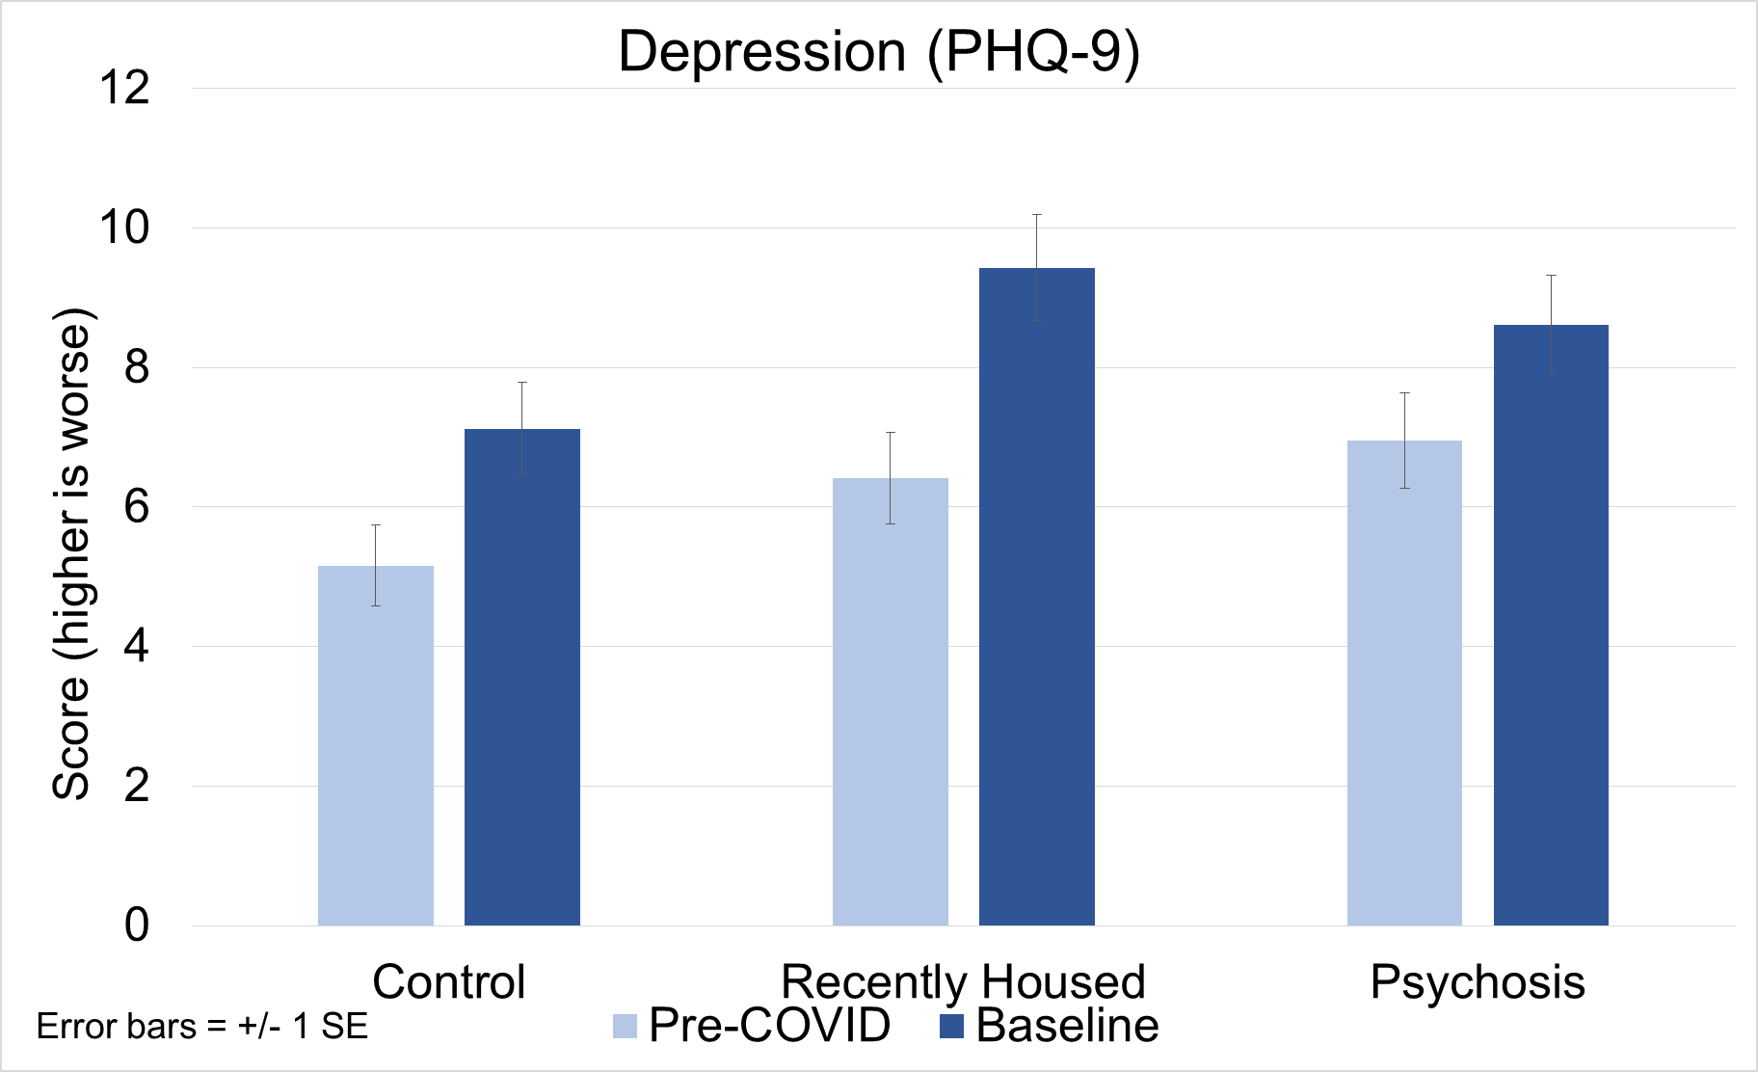
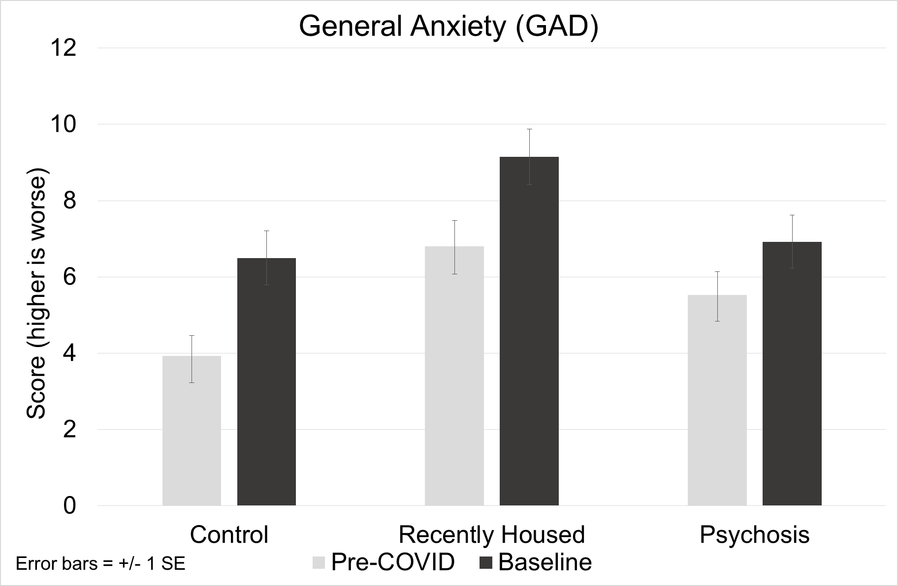
Depression and Anxiety
Time
Group
Time X Group
Time
Group
Time X Group
Recently housed > other

Slide 60
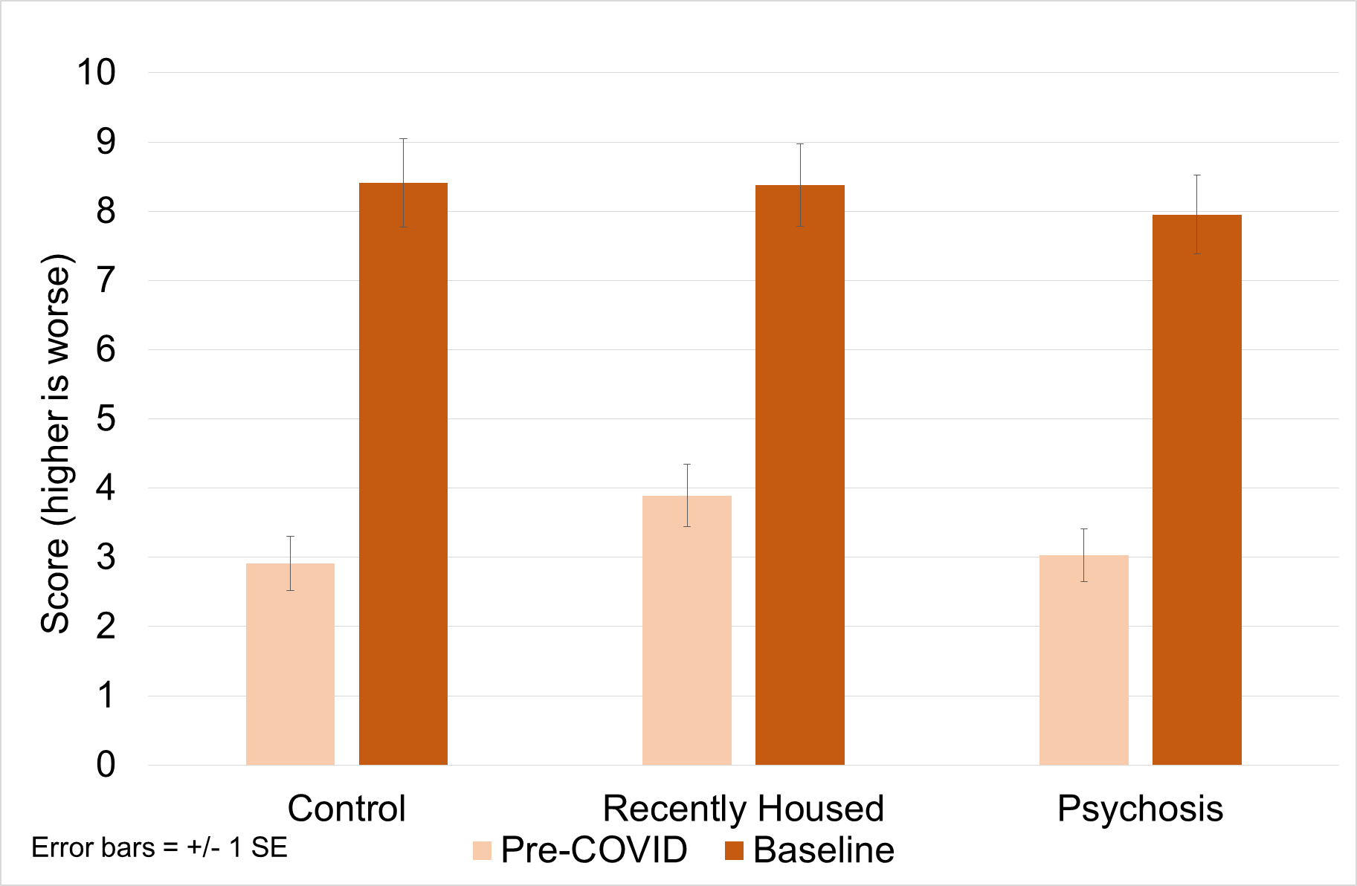
OCD - Contamination
Time
Group
Time X Group

Slide 61
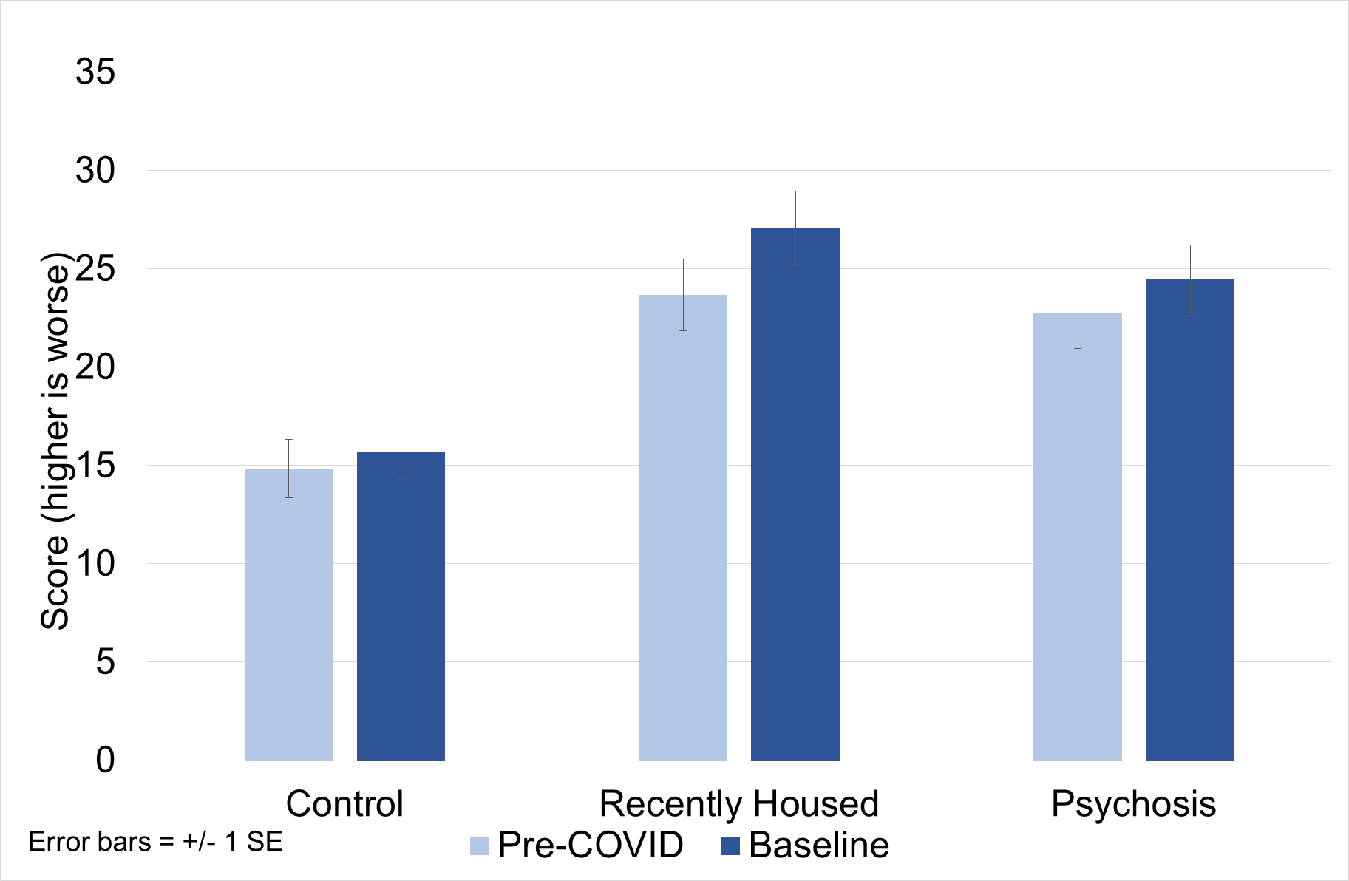
Loneliness
Time
Group
Time X Group

Slide 62
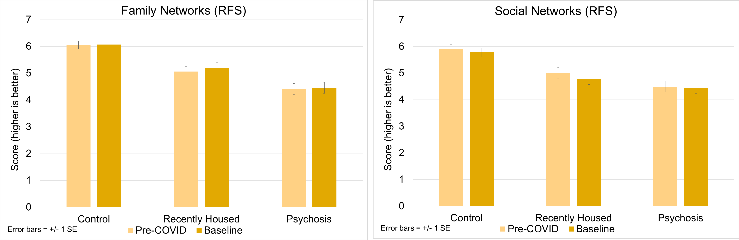
Role Functioning (RFS) – Family & Social
Time
Group
Time X Group
Time
Group
Time X Group

Slide 63
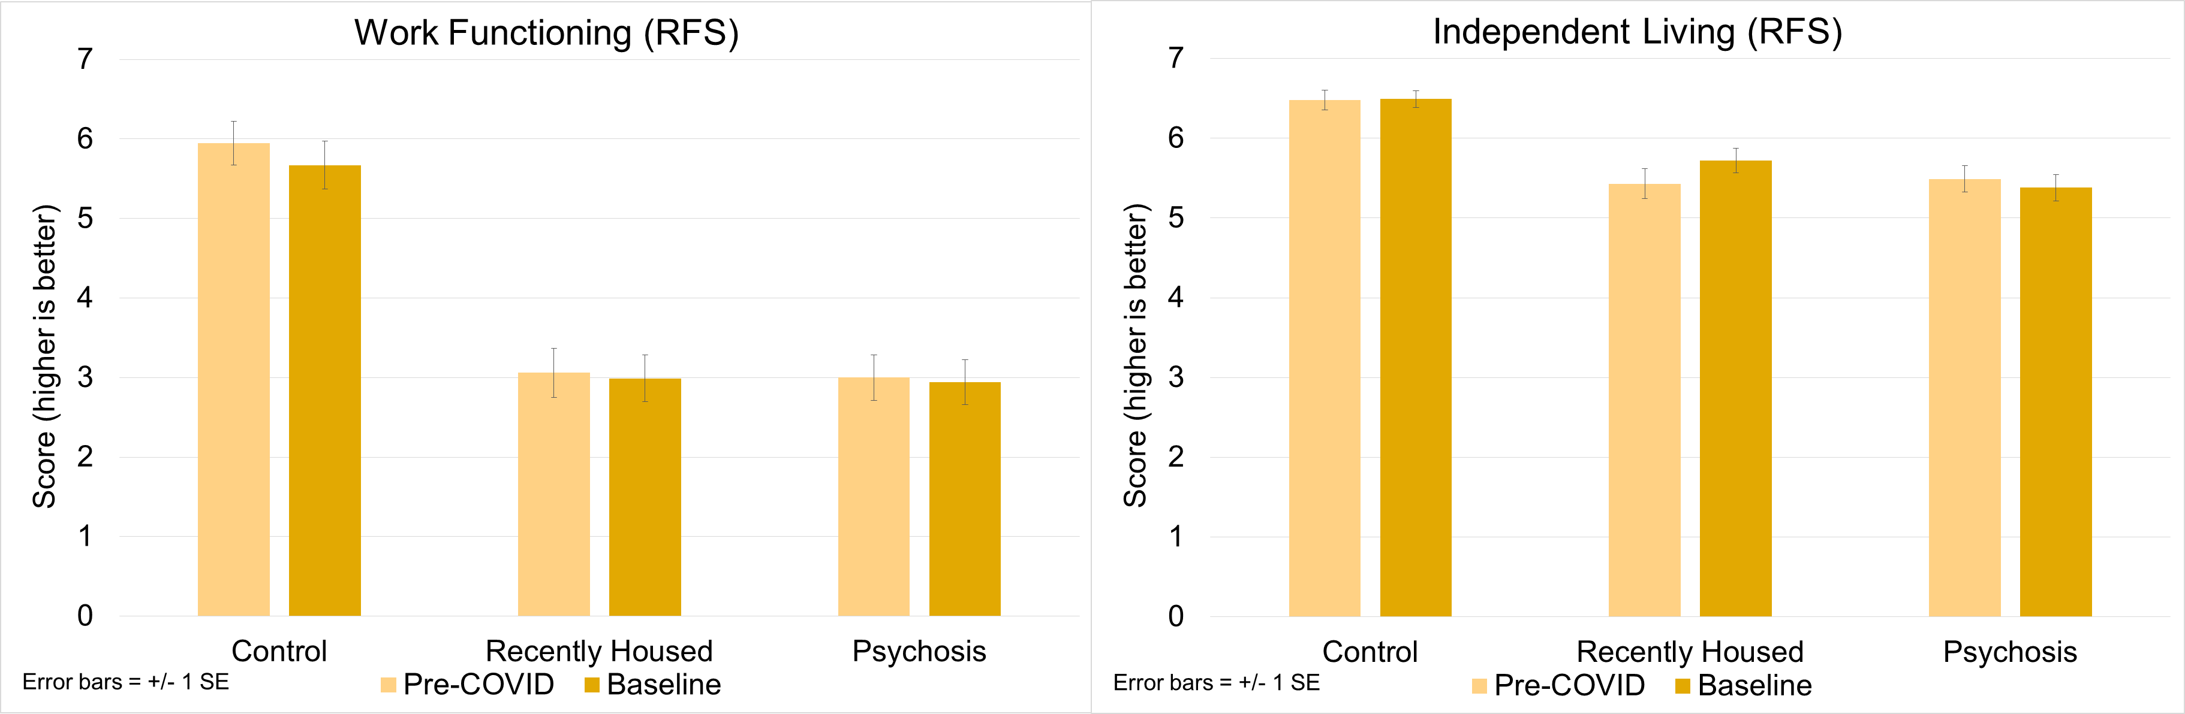
Role Functioning (RFS) – Work & Independent Living
Time
Group
Time X Group
Time
Group
Time X Group

Slide 64
Vulnerability and Protective Factors
Recently housed Veterans: higher perceived stress, more defeatist performance beliefs, engaged in more maladaptive coping strategies
 | Perceived Stress* | Defeatist Beliefs* | Maladaptive Coping*
Healthy Control | 20.6 (10.2) | 42.2 (19.5) | 21.3 (5.8)
Recently Housed | 23.8 (10.5) | 48.8 (18.9) | 23.2 (6.1)
Psychosis | 20.6 (10.0) | 48.9 (19.1) | 21.8 (5.9)
* RH > HC * RH, P > HC * RH > HC

Slide 65
Substance and Alcohol Use (ASI)
Alcohol Use
Cannabis Use
Pre-COVID
Baseline
Pre-COVID
Baseline
Psychosis
Baseline Group Differences
Alcohol: χ² = 15.6, p < .005
Cannabis: χ² = 27.3, p < .001
Psychosis
Recently
Housed
Recently
Housed
None
Moderate
Frequent
Control
Control

Slide 66
Food Insecurity: Obtaining
Recently housed Veterans reported significantly greater difficulty obtaining the food they need due to the pandemic and/or social distancing
χ² = 23.9, p < .001

Slide 67
Food Insecurity: Anxiety
Recently housed Veterans reported more distress about anticipated food shortage
χ² = 21.3, p < .001

Slide 68
Summary
All three groups of Veterans have been clinically impacted by the COVID-19 pandemic
  Increased depression, anxiety, loneliness, concerns about contamination
Among the groups, recently-housed Veterans have greater symptoms at baseline:
  Higher levels of anxiety and loneliness
  More likely to experience food insecurity, including food anxiety
  For vulnerability factors: Higher perceived stress, more defeatist performance beliefs, more maladaptive coping strategies

Slide 69
Summary
Compared with clinical psychiatric impact, changes in community integration due to the pandemic were relatively modest at baseline, but changes may occur over time.
Socioeconomic changes such as food insecurity are problematic (especially recently-housed Veterans) and may worsen over time.
Longitudinal data are needed for a fuller understanding of trajectories over time, longer-term consequences, and predictive value of risk / protective factors.
Ongoing Work:
  Follow-up quantitative interviews for all participants
  Qualitative interviews with a subset of participants

Slide 70

Thank you!

Slide 71

Discussion / Q&A

Slide 72
AVAILABILITY OF RECORDING
A recording of this session and the associated handouts will be available on ORPP&E’s Education and Training website approximately one-week post-webinar
An archive of this and other webinars can be found here: https://www.research.va.gov/programs/orppe/education/webinars/archives.cfm

